Slide 1
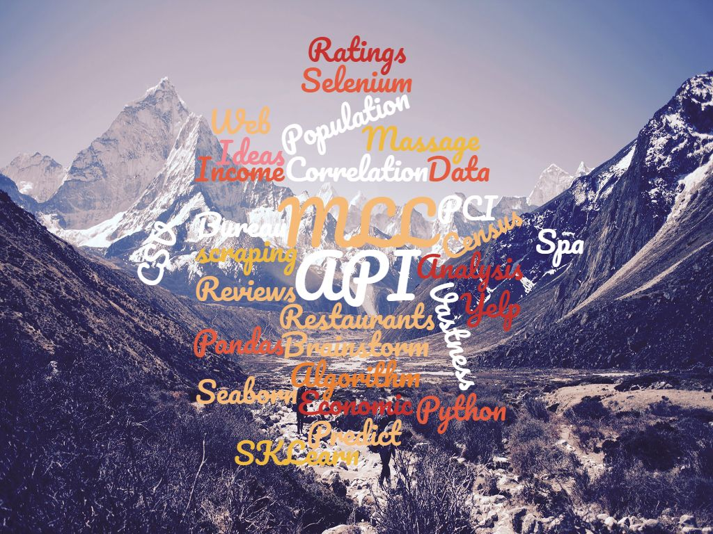
How to begin?
Notes:
The openness of these projects often leaves me feeling a bit uncertain of which direction to go. The vastness of data, can I find the data, quality of data, and will it lead to a dead end?

Slide 2

The questions
Can a prediction be made from this data? Ex., Is it a good idea to open a restaurant in Denver?
Is there a correlation between Per Capita Income(PCI) and some available business data from Yelp?

Slide 3

First Steps
Collect Data
Web scraping
API Calls
Yelp – Business Data
Bureau of Economic Analysis(BEA) - PCI
Census Bureau CSV download – Population
Clean and Organize Data
Remove all unnecessary data
Reformat and parse data
Create consistency between all dataframes
Notes:
I’ve found from previous projects that the first ideas have been dead ends. Not knowing if I can get the data and where it will lead has a certain since of adventure. Hence the choice of pictures throughout this slide. I also wanted to use a ML king jr quote because I wanted to point out awareness of the effect of ML algorithms design on real people. My first steps were, the list. Talk on what was some unnecessary data(, (), ‘ ‘ , lower, capital cases, town, city, independent, county).

Slide 4


First Databases
Databases
Yelp Business
Spa – 59,000
Rest – 66,000
Population
- 81,500 Cities
PCI
- 3140 Cities
State Abbr.
Merge
St. Abbr -> Yelp & Pop
PCI -> Pop
Pop -> Yelp

Slide 5

Obstacles
API limitations
Web scraping and multi filters
Availability of data
Missing data
Unexpected Breaks

Slide 6
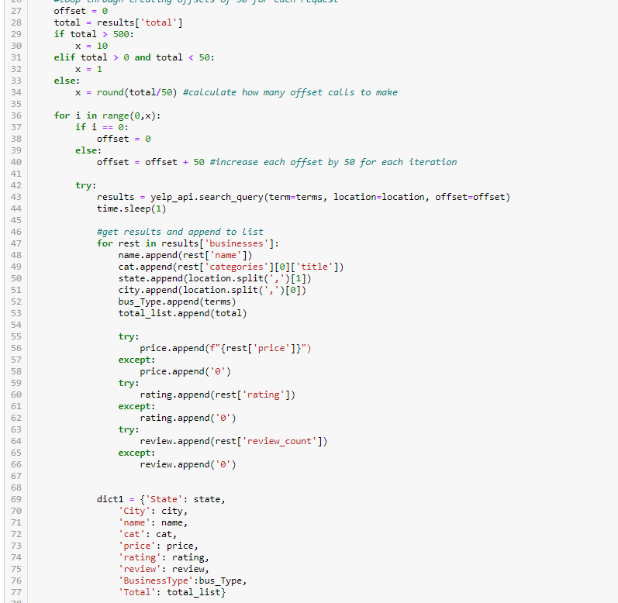

Overcoming Obstacles
API
Notes:
Time.sleep() – try & except, offset loop, append list of dictionary, start where left off from, handling missing data, don’t forget to turn off sleep ☺

Slide 7
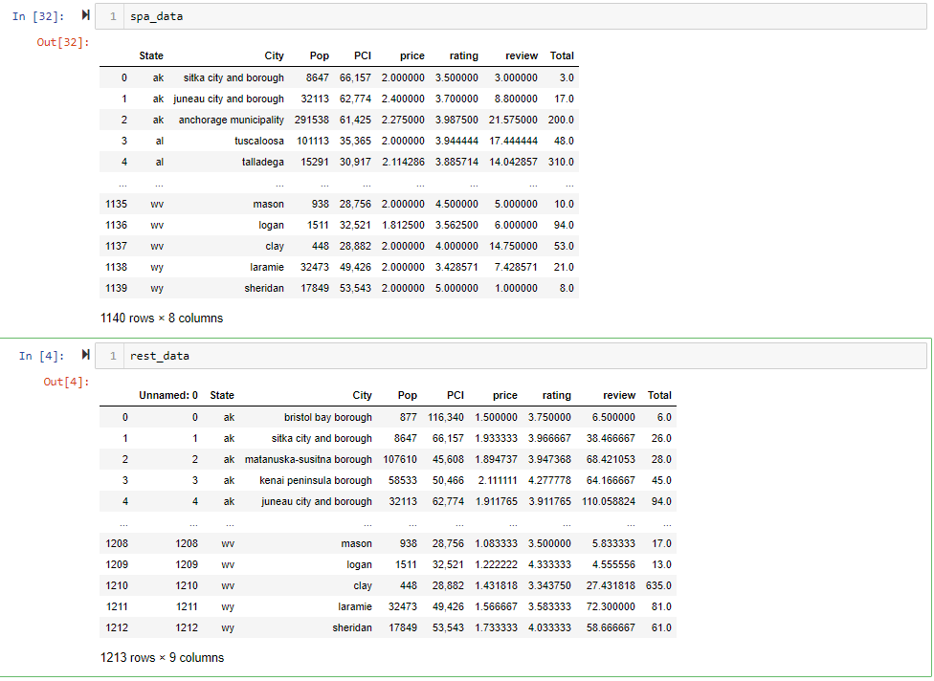
Create an aggregate database for ml models

Slide 8
Will there be any correlation?

Slide 9
The unspoken problem.

Slide 10
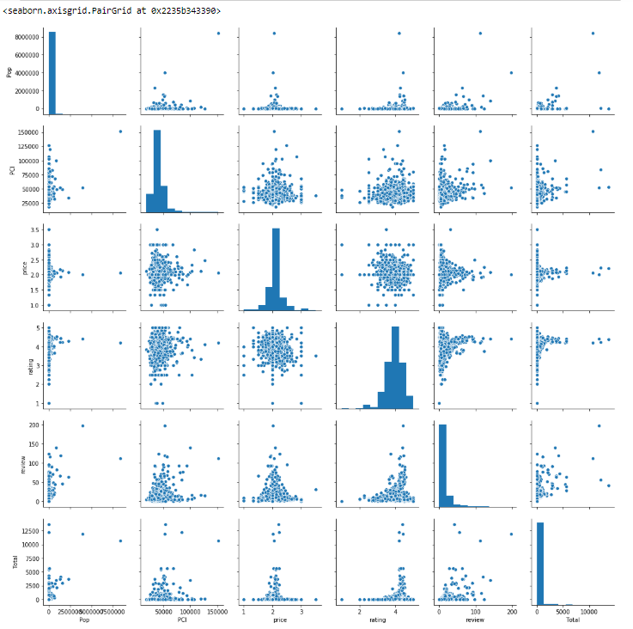
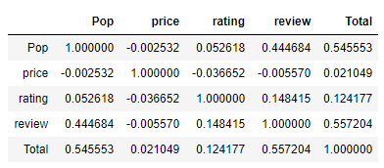
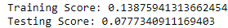

Slide 11
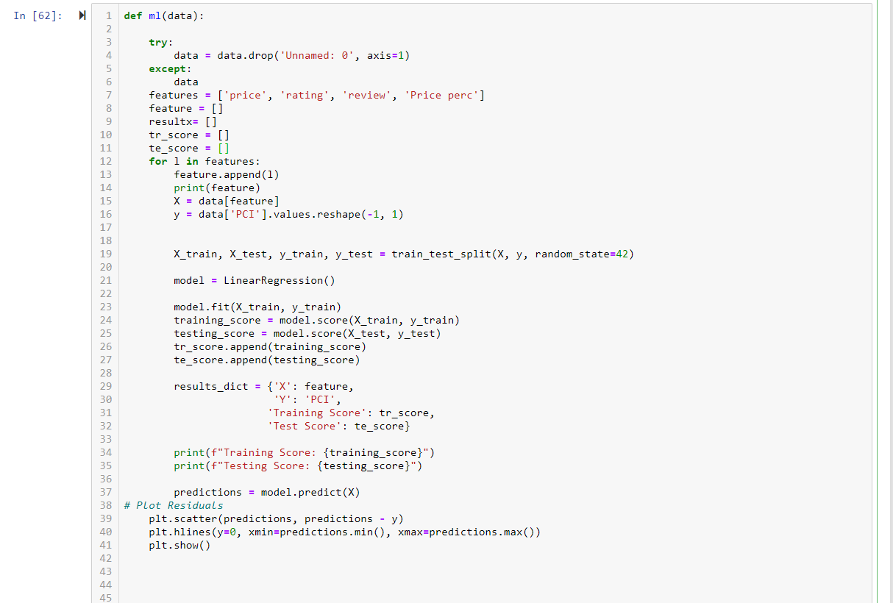

Deeper dive – new databases
API
Hotel Data
High priced for every Database
Low priced for every Database
High Population
Hotels Per Person vs Restaurants Per Person
Notes:
Time.sleep() – try & except, offset loop, append list of dictionary, start where left off from, handling missing data, don’t forget to turn off sleep ☺

Slide 12

Fellow classmates, Thank you!
You’re all awesome!
TA’s, Thank you!
You’re also super awesome!
And of course….
Svitlana, thank you so much!
You’re extra super awesome!

Slide 13
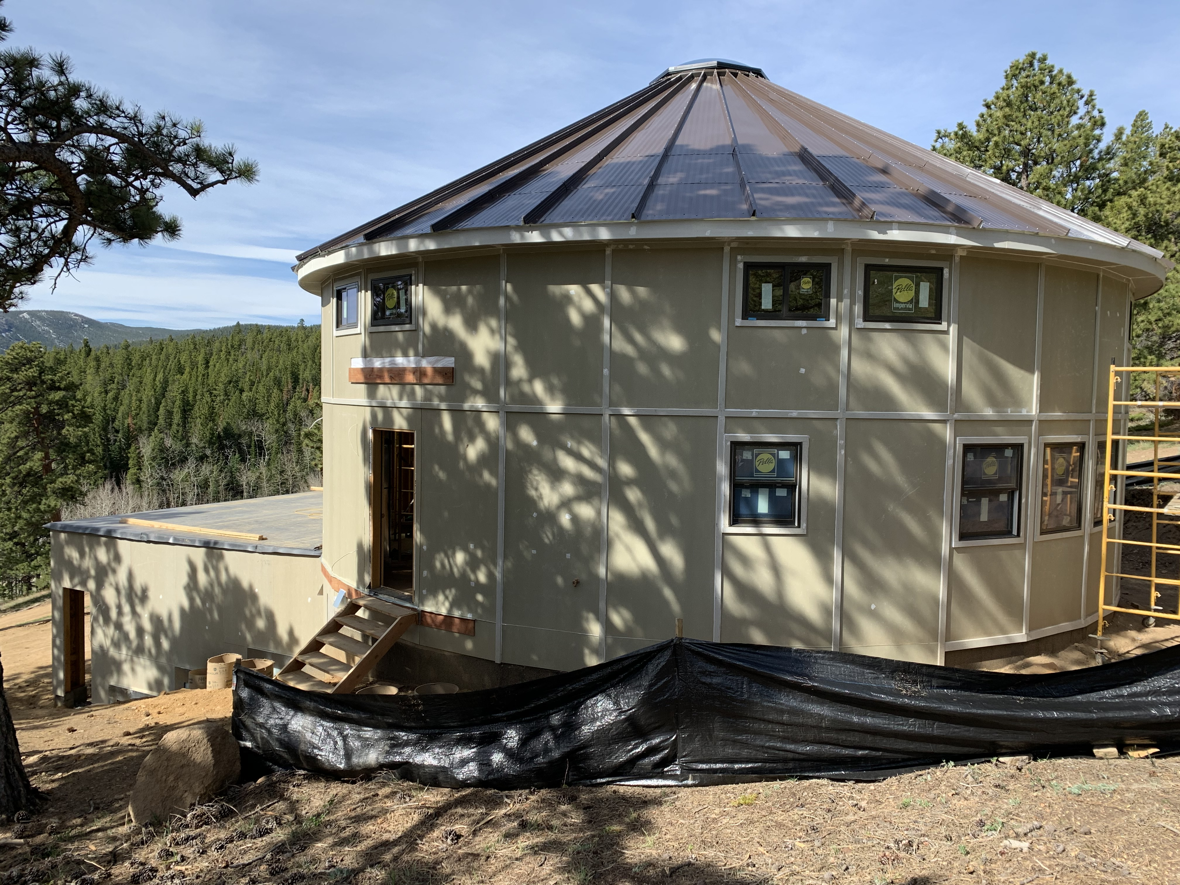

Slide 14
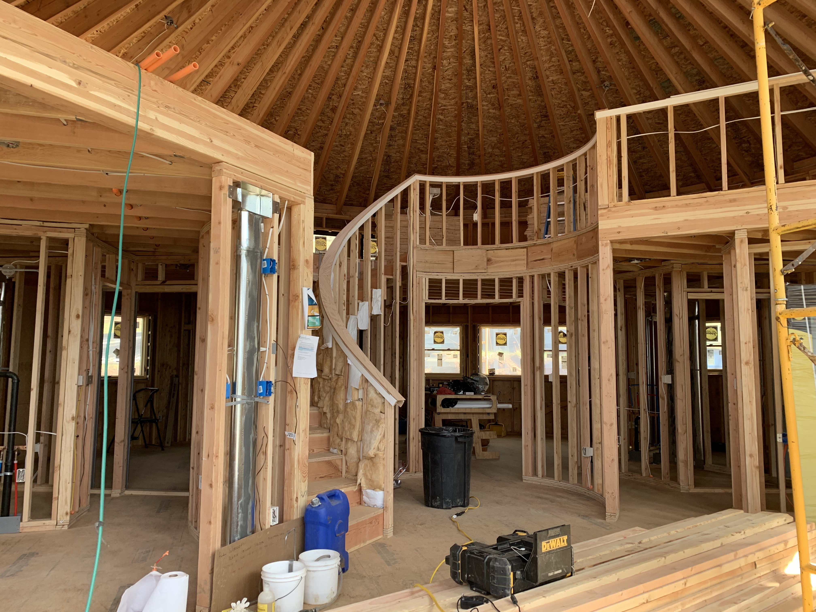
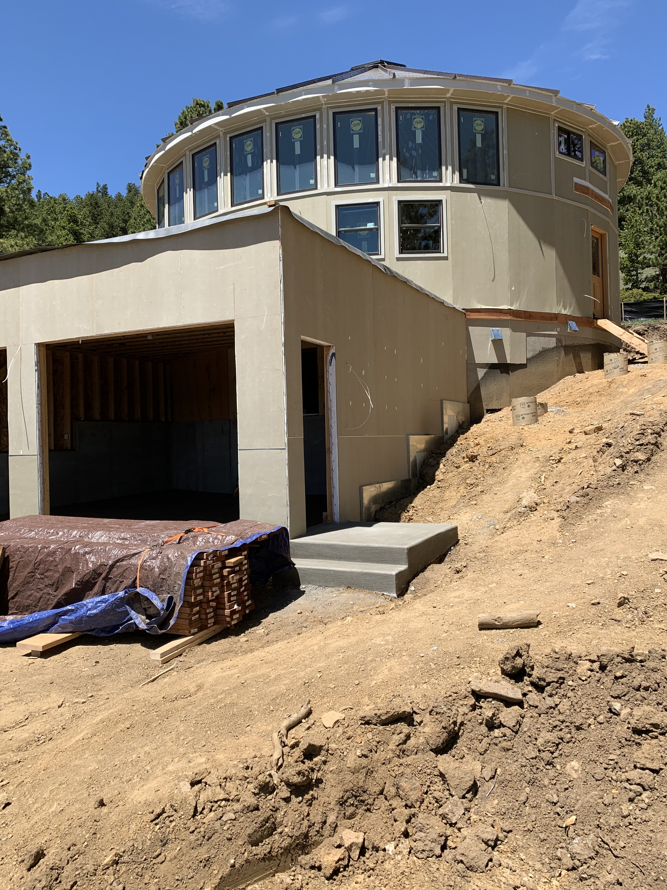

Slide 15
